Slide 1

OZARKA COLLEGE SELF-STUDY
STYLE GUIDE

Slide 2
Criterion Template
Each criterion should be organized in the following way:
  Criterion#: Criterion Statement
  Ozarka College: Criterion Overview
  Core Component #A
  Core Component #B
  Core Component #C
  etc.
Follow the provided template.

Slide 3
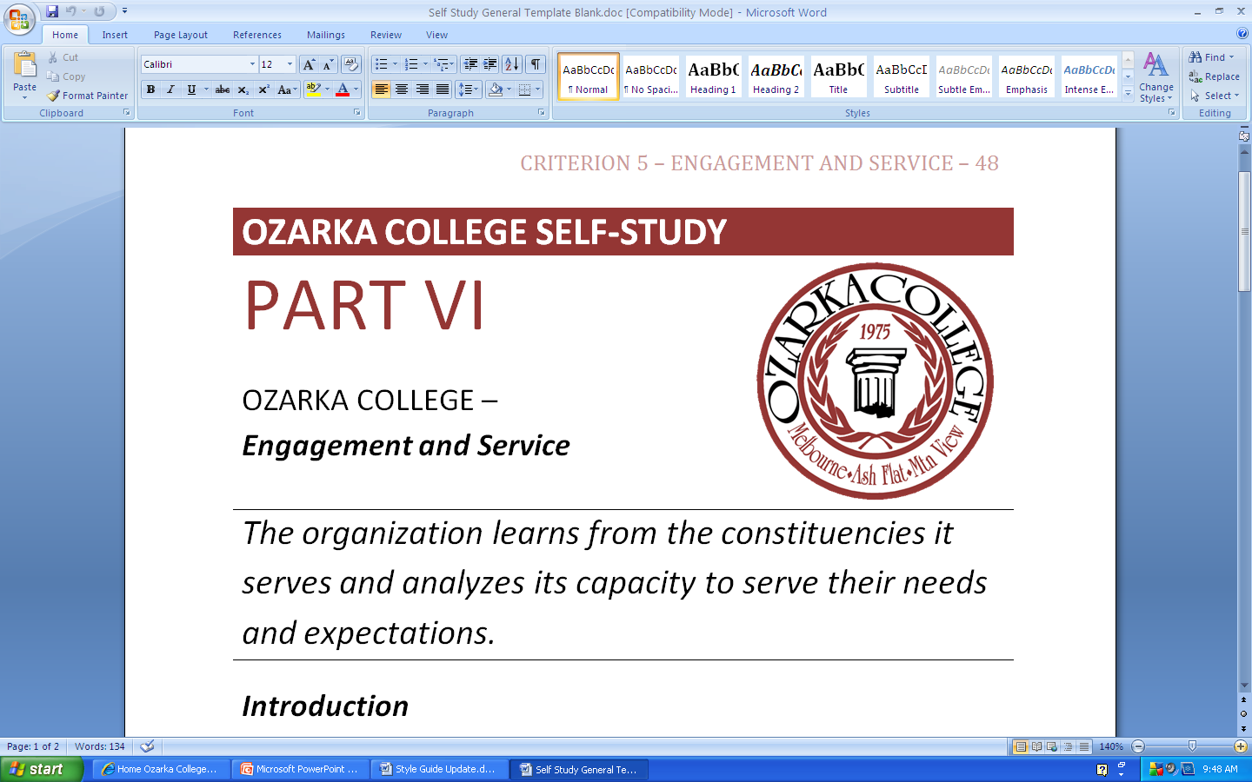
Criterion Template

Slide 4
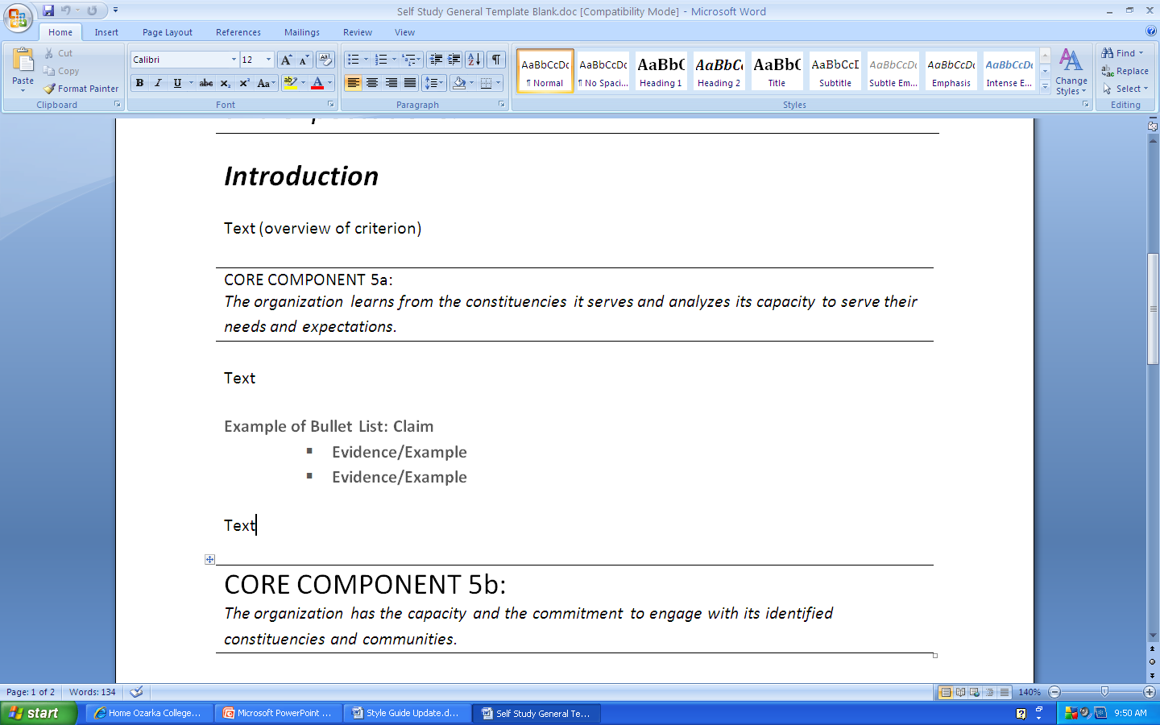
Criterion Template

Slide 5
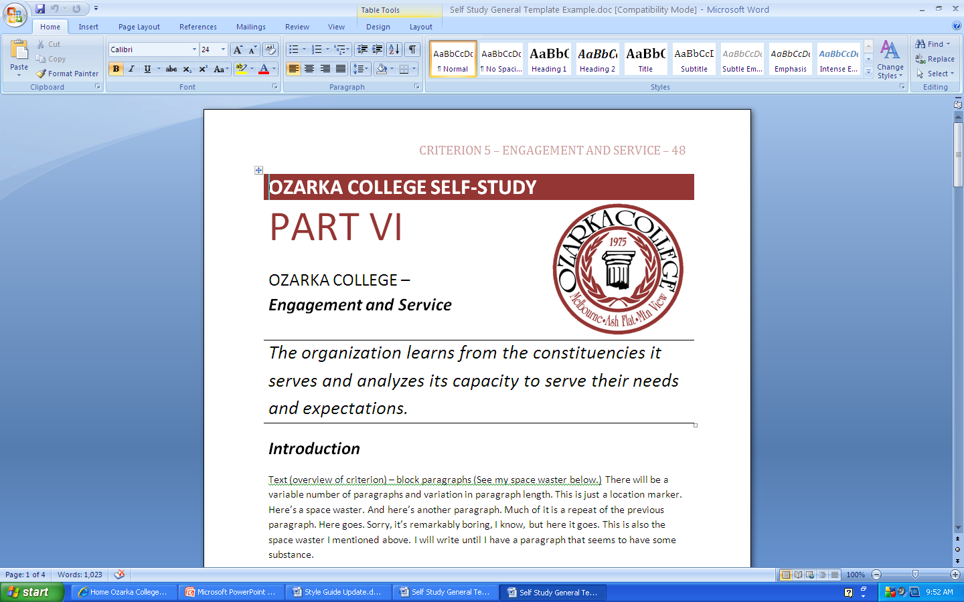
Criterion Template

Slide 6
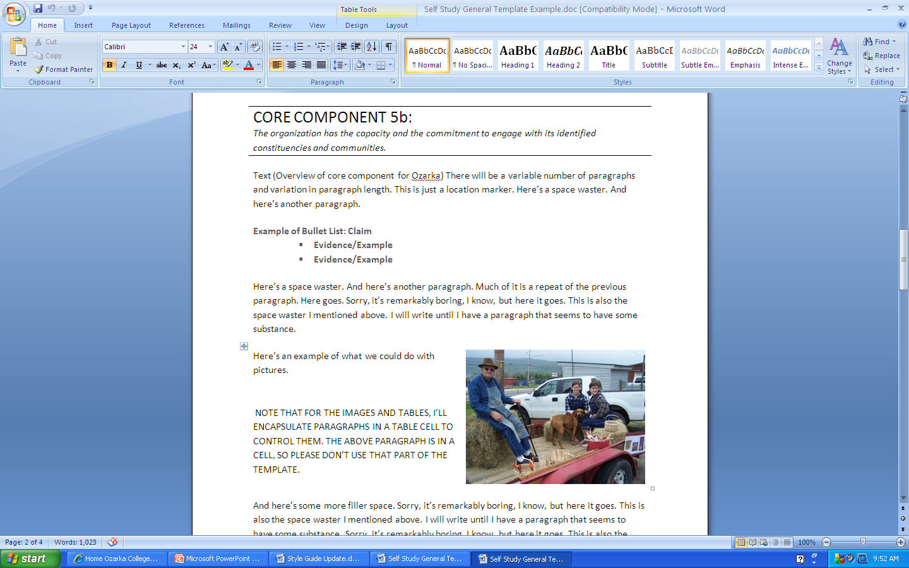
Criterion Template

Slide 7
Basics
Font Size/Type
  Please use Calibri font size 12 (not the default for Microsoft Office 2007).
Spacing
  Write your drafts in 1.15 spacing. Remove the “Add Space After Paragraph” option but manually space between paragraphs.

Slide 8
Basics
Bullets and Numbering
  Use bullets unless there is a clear reason to use numbers. Do not use a Roman numeral outline format.
Paragraphs
  Write in block paragraphs (do not indent). Add a space manually between paragraphs.

Slide 9
Basics
Charts
  Save and submit charts separately from your drafts. When referring to charts within your drafts, follow the indexing examples set below.
Tables
  For tables, please use the template provided in the Style Guide.

Slide 10
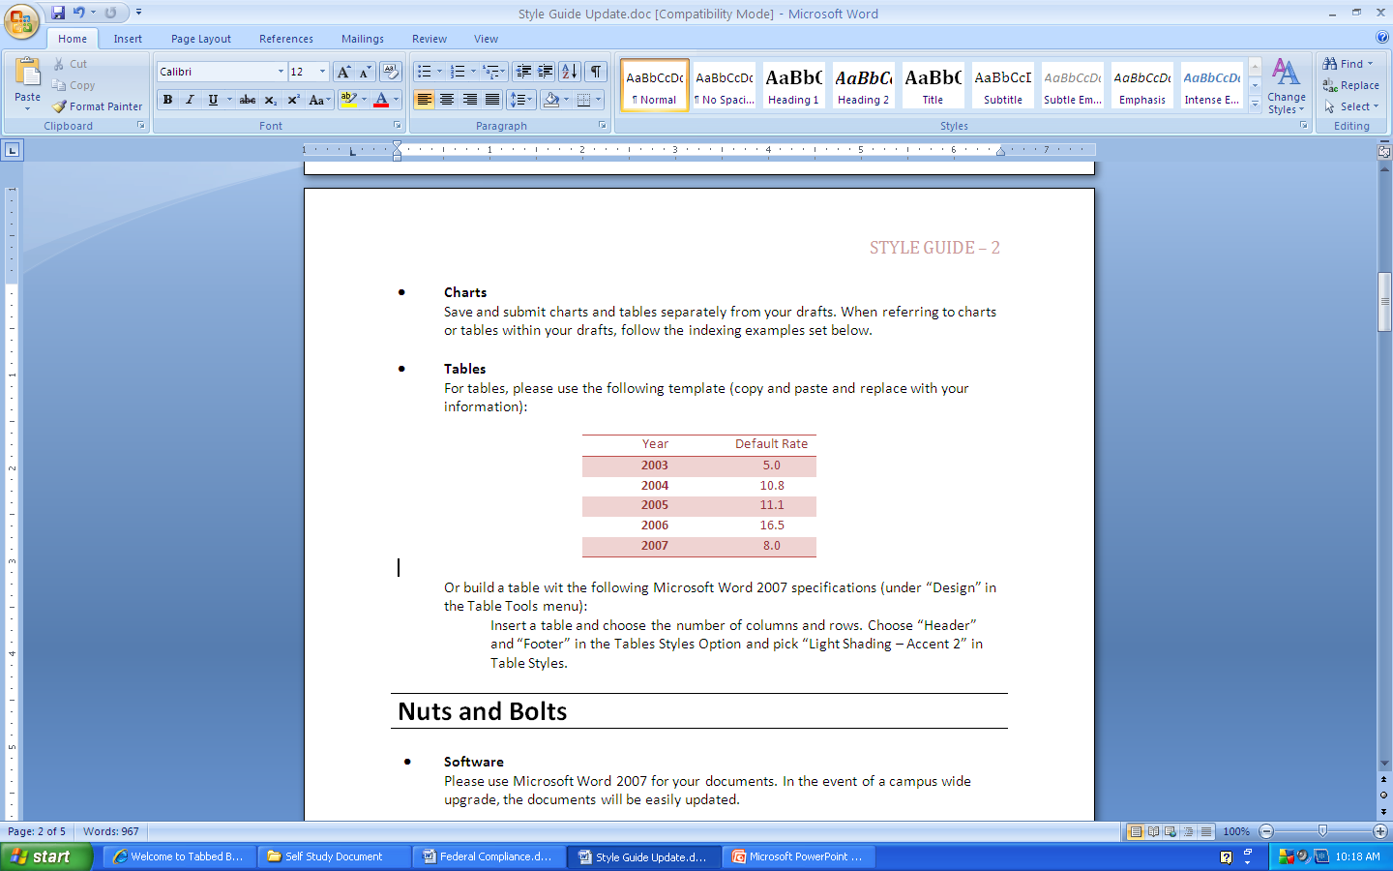
Basics

Slide 11
Basics
  Or build a table with the following Microsoft Word 2007 specifications (under “Design” in the Table Tools menu):
    Insert a table and choose the number of columns and rows. Choose “Header,” “Footer,” and “Banded Rows” in the Tables Styles Option and pick “Light Shading – Accent 2” in Table Styles.

Slide 12
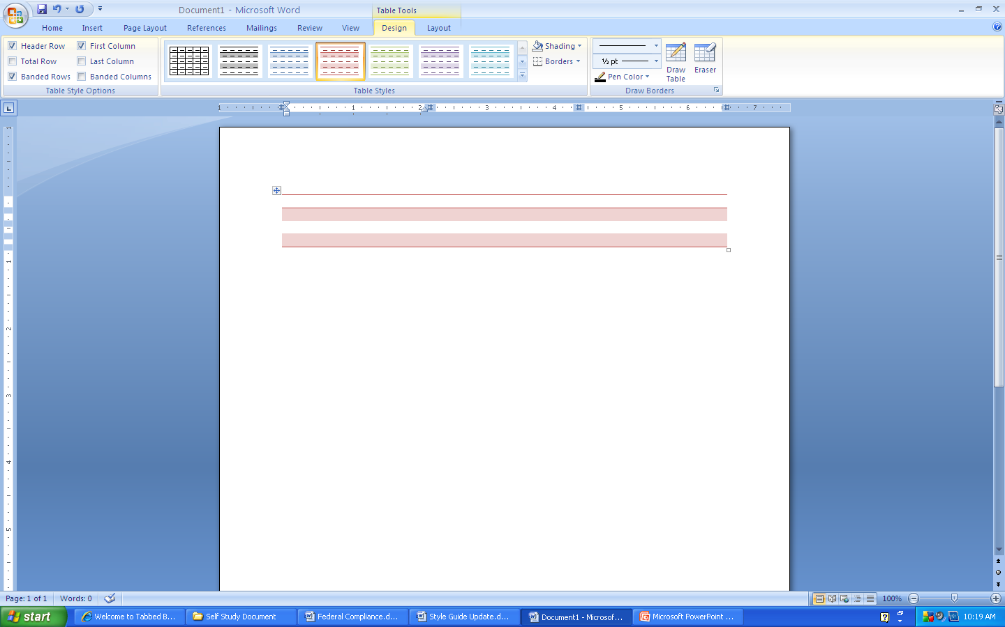
Basics

Slide 13
Nuts and Bolts
Software
  Please use Microsoft Word 2007 for your documents. In the event of a campus wide upgrade, the documents will be easily updated.
Saving and Naming Files
  Save documents in Microsoft Word as a document file.
  Name files using the following format:
    Name: 2-Preparing for the Future-2a
    For Charts or Graphs: 2-Preparing for the Future-2aChart1

Slide 14
Referencing and Citing Sources
Indexing
  When referencing a particular section in your draft, refer to the section as in the following example:
    C2intro (for Criterion 2 Introduction)
    C2a (for Core Component C2a)
  These references will be changed to page numbers in the final draft.

Slide 15
Referencing and Citing Sources
Citing Sources
  If citing outside sources, make sure to provide the editors and the Resource Room with copies of the sources used.
  In the text of the Self-Study, refer to the title followed by the year and page number (if applicable) in parentheses. See the following example:
  In the article Trends in Higher Learning (2009 p. 17) we read, “borrowed material.”

Slide 16
Names and Acronyms
The College
  When referring to Ozarka College, please use one of the following terms:
    Ozarka College
    Ozarka
    the College
    the Institution
  Note the capitalization of these terms.

Slide 17
Names and Acronyms
Acronyms
  For standard acronyms, do not use periods between letters (for example, “GED” instead of “G.E.D.”
  If an acronym is not commonly known, define it at its first use.
  Following is a list of acronyms for standard use:
    ADHE – Arkansas Department of Higher Education
    HLC – The Higher Learning Commission
    Do not refer to Ozarka College as “OC.”

Slide 18
Names and Acronyms
Ash Flat and Mountain View
  Refer to the Ash Flat and Mountain View locations as “sites” rather than “campuses.”
Organizational Structure Names
  When referring to specific positions at Ozarka College, use titles provided on the “Personnel and Primary Functions Organizational Structure” document.

Slide 19
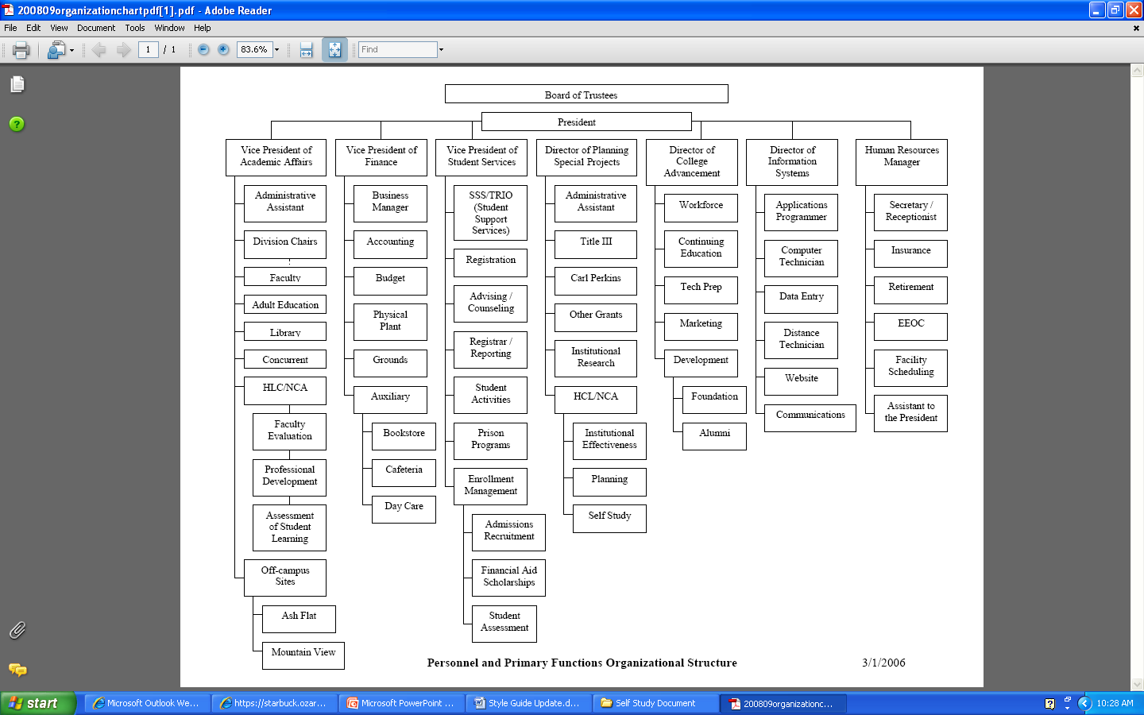
Names and Acronyms

Slide 20
Names and Acronyms
Refer to the hierarchy of “groups” at the college using the following terms when not referring to specific individuals:
  Board of Trustees
  Office of the President
  Office (Office of Student Services, Office of Planning and Special Projects, Office of Information Systems, etc.)

Slide 21
Names and Acronyms
  Division (Nursing and Allied Health Division, Applied Science Technology Division, Math Science and Education Division, Arts and Humanities Division)
  Department (Automotive Department, Social Sciences Department, etc.)

Slide 22
Names and Acronyms
Make sure that when referring to the positions of specific individuals you use the correct position title as indicated in the catalog.

Slide 23
TONE/VOICE
The tone of the Self- Study should be objective.
Avoid first person pronouns (I, me, we) and second person pronouns (you) in your writing.
Avoid subjective judgments. Evaluations should be based on clearly defined criteria.

Slide 24
SENTENCE STYLE
Plural vs. Singular
  Generally, use the words “staff” and “faculty” as singular nouns. If you encounter a situation where this would be awkward, you can substitute phrases such as “faculty members” or “staff members.”
  Examples:
  The staff at Ozarka evaluates goals based on the following . . . .
  Faculty members evaluate goals based on the following . . . .

Slide 25
SENTENCE STYLE
Parallel Structures
  When writing a series of words, phrases, or clauses, make sure that all items in the series are parallel unless there is a clear reason otherwise.
  Examples:
The task force evaluated concerns, gathered data, and proposed a solution.
Instead of:
The task force evaluated concerns, gathered data, and it proposes solutions.

Slide 26
SENTENCE STYLE
Contractions
  Avoid contractions in your drafts (“cannot” instead of “can’t,” etc.)
Shifts
  Avoid unnecessary shifts in tense, mood, number, and pronouns.
  Examples:
Faculty members are responsible for several assessment activities so that they are prepared . . . .
Instead of:
Faculty members are responsible for several assessment activities so that you are prepared . . . .

Slide 27
MECHANICS
Capitalization
  Capitalize only proper names unless otherwise indicated. Do not capitalize for emphasis.
Numbers
  In the text of paragraphs, write out numbers that can be written in one to two words. Always write out a number if it begins a sentence.
  If a number is three or more words, use the numeral.
  Use numerals for dates, times, and addresses.

Slide 28
MECHANICS
Examples:
  Three faculty members attended the conference.
  The Board of Trustees met seven times during this period.
  Student enrollment in the program was 519 in the fall of 2009.

Slide 29
PUNCTUATION
Colons and Lists
  When using a colon (:) to introduce a list, make sure that an independent clause precedes the colon.
  Examples:
    The following financial aid options are available for students: grants, scholarships, and loans.
  Instead of:
    Students can apply for: grants, scholarships, and loans.

Slide 30
PUNCTUATION
Semicolons and Complex Lists
  Use semicolons (;) to separate items in a series that are complex or contain internal punctuation.
Example:
    Representatives were present from Melbourne, Arkansas; Nashville and Columbia, Tennessee; and Big Water, Utah.

Slide 31
A Work in Progress
This style guide is a work in progress. As we continue writing the self-study, we’ll expand on this document as needed.
Please forward any suggestions to
Judy Sharp (jsharp@ozarka.edu)
(or)
Jeremy Nicholson (jnicholson@ozarka.edu)

