Slide 1
Assessment
Taking a Closer Look at Improving Ozarka College through Assessment Activities

Slide 2
Focus on Focus
Higher Learning Commission
  Recommended Review of General Education Outcomes
  Suggested Enhanced Assessment Activities
    More evidence and documentation
    More use of data to implement campus improvements and drive budgets

Slide 3
Assessment
Assessment Defined:
  Assessment is the process of documenting, in measurable terms, certain knowledge, skills, attitudes and beliefs.

Slide 4
Assessment Types
Assessment can be classified:
  Formative or Summative
  Objective or Subjective
  Informal or Formal

Slide 5
Formative v. Summative
Formative: happens throughout the course or project to aid learning or improvement
  Example: CATS (Classroom Assessment Techniques…muddiest point)
Summative: happens at the end of the course or project
  Example: Comprehensive final, CE course evaluation

Slide 6
Objective v. Subjective
Objective: questioning has a single answer or response
  Example: T/F or multiple choice questions
Subjective: questioning has more than one correct answer
  Example: essay question or survey

Slide 7
Formal v. Informal
Formal assessment involves written documentation
  Example: a test, a survey, etc.
Informal assessment is casual or random
  Example: observation, participation, peer review, discussion, focus groups.
AKA Quantitative and Qualitative

Slide 8
Good Assessment
Is valid: measures what it is intended to measure
Is reliable: consistent and accurately completed without bias

Slide 9
Ozarka’s Assessment Cycle
Determine what assessment activity to do based on the information you want
Conduct the assessment activity using a reliable and measurable method
Look at (really analyze) the information you obtain from the assessment activity
Decide what you’ve learned and how you can incorporate that information to improve your processes & functions

Slide 10
Assessment And Planning Loop
Check Feedback Loop and Plan Accordingly for the Future
Individual Goals for Staff
Goals for Committees and Task Forces
Goals for Divisions and Departments
Individual Goals for Instructors
Tie Everything to the Budget

Slide 11
Tools we have
Assessment Matrix
Assessment Calendar
Assessment Glossary
Planning Manual and Results
Budgeting Process
College Planning and Effectiveness Committee

Slide 12
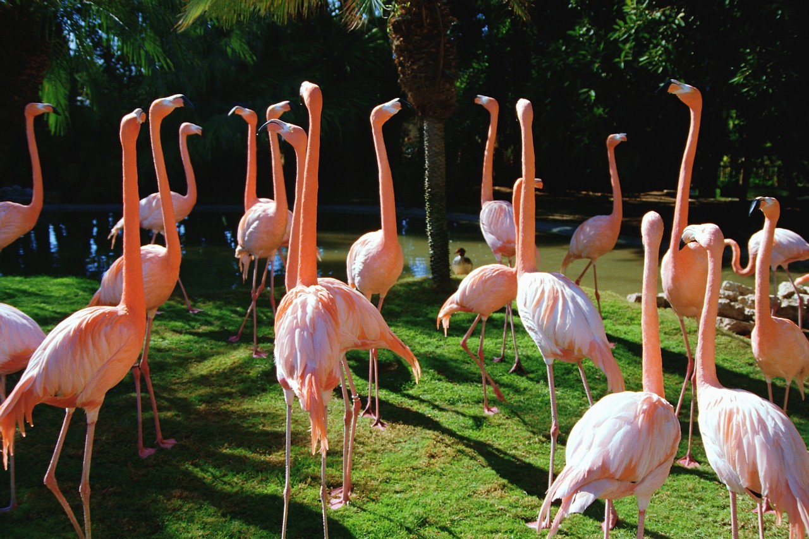
Activity/Discussion
Review the assessment calendar. Discuss examples you’ve seen where campus improvements followed assessment data. Also discuss evidence needed for improvements.

Slide 13
Summary Comments
Document your assessment plans
Document your assessment results
Document your use of the assessment information
All this equals evidence for HLC!

